Slide 1
Semiconductor Physics
and
Computational Methods
Dr. Elangovan Elamurugu
iDARE Laboratory, Department of Physics and Nanotechnology, SRMIST

Slide 2
Introduction to Classical Free Electron Theory
Free Electron Theory
The electron theory of materials is used to explain the structure and properties of solids through their electronic structure.
It also gives information about bonding in solids, energy levels in metals and cohesive & repulsive forces in metals.
Development of Free Electron Theory
The Classical free electron theory (Drude and Lorentz): It is a macroscopic theory, which states that the free electrons are in the lattice, and it obeys the laws of Classical Mechanics. Here the electrons are assumed to move in a constant potential.
The Quantum free electron theory (Sommerfeld Theory): It is a microscopic theory, which states that the electrons are in the lattice and moves with a constant potential and it obeys law of Quantum Mechanics.
Brillouin Zone Theory (Band Theory): This theory states that the electrons move with a periodic potential provided by periodicity of crystal lattice. It explains the mechanisms of conductivity, semi-conductivity on the basis of energy bands and hence it is called as band theory.

Slide 3
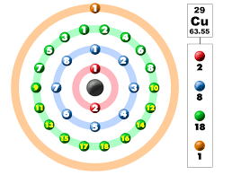
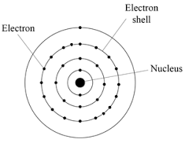
Introduction to Classical Free Electron Theory
According to kinetic theory of gases in a metal, Drude and Lorentz has assumed that free electrons are nothing but a gas of electrons.
Drude-Lorentz Theory: This theory initially proposed by Drude in 1900, and it is the first theory to explain the electrical conduction in conducting materials and reveals that free electrons are responsible for the electrical conduction.
Free Electrons: In certain metals (Examples: Cu, Ag and Al), the valence electrons are so weakly attached to the nuclei they can be easily removed or detached. Such electrons are called as Free Electrons. But all the valence electrons in the metals are not free electrons.

Slide 4
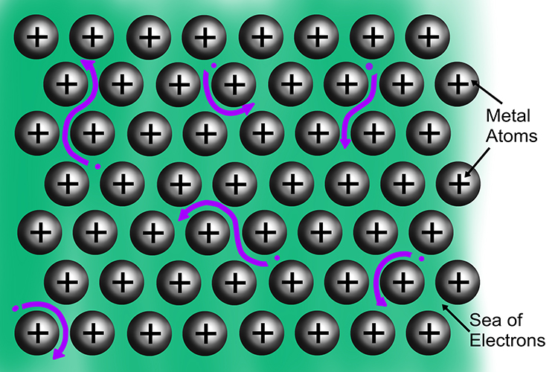
Introduction to Classical Free Electron Theory
Concept of Classical Free electron Theory
According to this theory, metals consists of positive ions fixed in lattice and negative ions move freely within the boundaries of the metal.
As they are responsible for conductivity called as Conduction electrons
This cloud of free electrons are called as electron gas
They differ from ordinary gas in two aspects
Free electron gas is charged while molecules of ordinary gases are neutral
Concentration of electron is > ordinary gas concentration

Slide 5
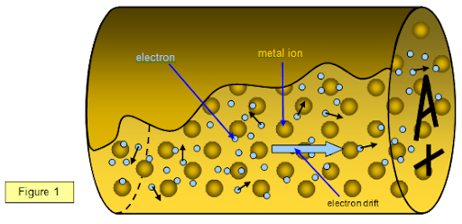
Introduction to Classical Free Electron Theory: Basic Terminologies
Bounded Electrons: Valence electrons in isolated atoms bound to their parent nuclei are bounded electrons.
Free electrons: In a solid many atoms are present whose boundaries overlap. Hence the valence electrons find continuity to move and are termed free electrons.
Free electron gas: Collection of free electrons is termed as free electron gas. It is charged.

Slide 6
Introduction to Classical Free Electron Theory: Basic Terminologies
Electric Field (E): It is defined as potential drop (V) per unit length (l).
Current density (J): Current flowing through a solid per unit area is current density.
Drift Velocity (V_{d}): The average velocity acquired by the free electron in a particular direction, due to the application of electric field.
Mobility (µ): Drift velocity acquired by the free electron per unit electric field applied to it is mobility.
Relaxation Time (τ): Relaxation time can be defined as the time taken for the drift velocity of the electron to decay to 1/e of its initial value.
Collision Time (τ_{c}): The average time taken by the free electron between two successive collisions is known as collision time.
Mean Free Path (λ) : The average distance travelled by an electron between two successive collisions in the presence of an applied field is known as mean free path.

Slide 7
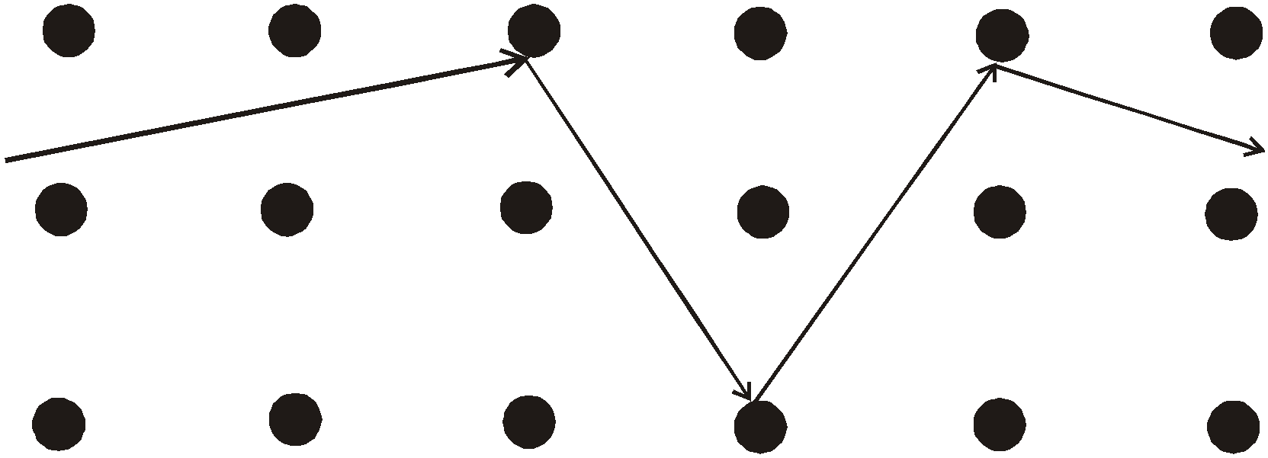
Classical Free Electron Theory of Metals
Electrons are assumed to achieve thermal equilibrium with their surroundings only through collision. These collisions are assumed to maintain local thermodynamic equilibrium in a particularly simple way.
Trajectory of a conduction electron

Slide 8
Classical Free Electron Theory of Metals
Success of classical free electron theory:
It verifies Ohm’s law.
It explains the electrical and thermal conductivities of metals.
It derives Wiedemann – Franz law. (relation between electrical conductivity and thermal conductivity)
It explains optical properties of metals.
Drawbacks of Classical Free Electron Theory:
It fails to explain the electric specific heat and the specific heat capacity of metals.
It fails to explain ferromagnetism, superconducting properties of metals etc.
It fails to explain new phenomena like Photoelectric Effect, Compton effect, Black Body Radiation, etc.
It fails to explain electrical conductivity of semiconductors or insulators.

Slide 9
Quantum Free Electron Theory
Classical free electron theory could not explain many physical properties.
In 1928, Sommerfield developed a new theory applying quantum mechanical concepts and Fermi-Dirac statistics to the free electrons in the metal. This theory is called quantum free electron theory.
Classical free electron theory permits all electrons to gain energy. But quantum free electron theory permits only a fraction of electrons to gain energy.
According to Quantum mechanics moving particles has some sort of wave motion, then wavelength λ= h/p (De-Broglie wavelength). Where, = h is Planck's constant (6.63 x 10⁻³⁴ J s) and p is momentum.
To characterize moving particle having wave motion-(ψ)- wavefunction is introduced.
According to quantum theory of free electrons energy of a free electron is given by: E_{n} = n²h²/8mL²
According to quantum theory of free electrons the electrical conductivity is given by: σ = ne²T/m

Slide 10
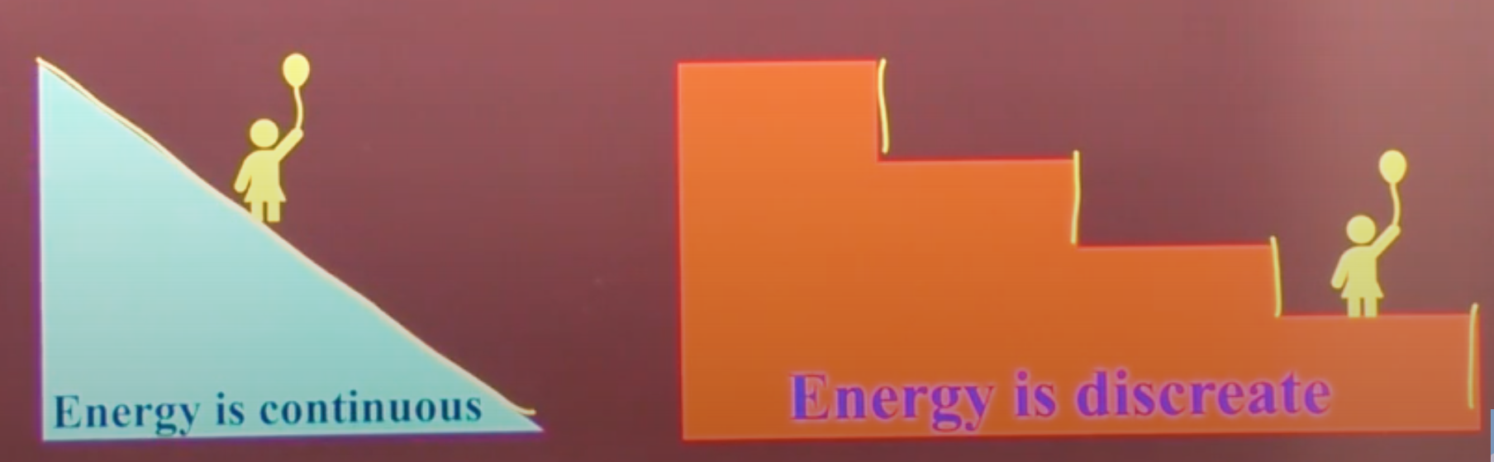
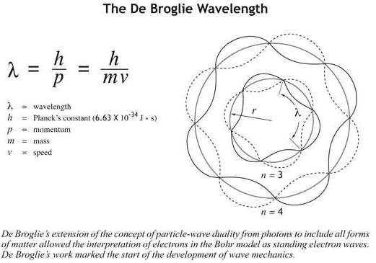
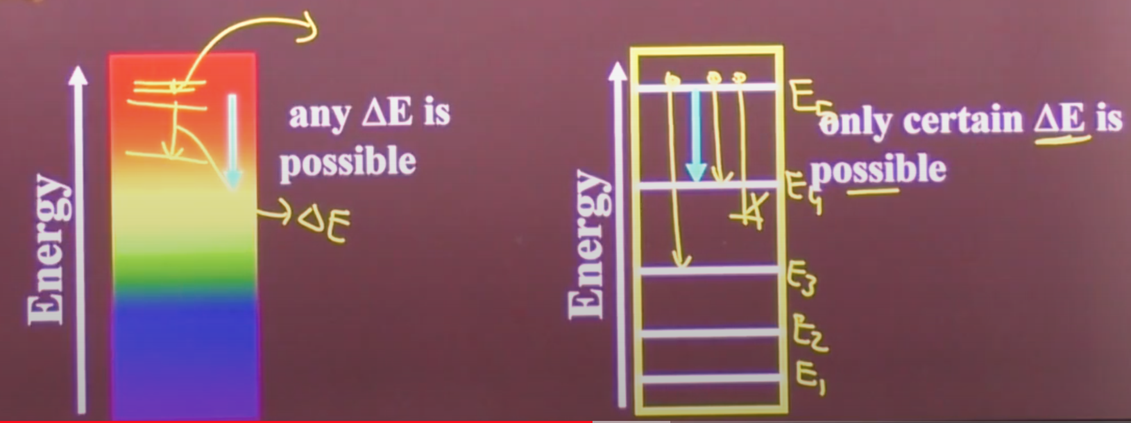
Quantum Free Electron Theory

Slide 11
Quantum Free Electron Theory
Merits of Quantum Free Electron Theory:
It successfully explains the electrical and thermal conductivity of metals.
We can explain the Thermionic phenomenon.
Temperature dependence of conductivity of metals can be explained by this theory.
It can explain the specific heat of metals.
It explains magnetic susceptibility of metals.
Demerits of Quantum Free Electron Theory:
It is unable to explain the metallic properties of exhibited by only certain crystals.
Failed to give difference of metals/semiconductors/ insulators.
It is unable to explain why the atomic arrays in metallic crystals should prefer certain structures only.

Slide 12

Questions & Feedback, Please!

